Slide 1
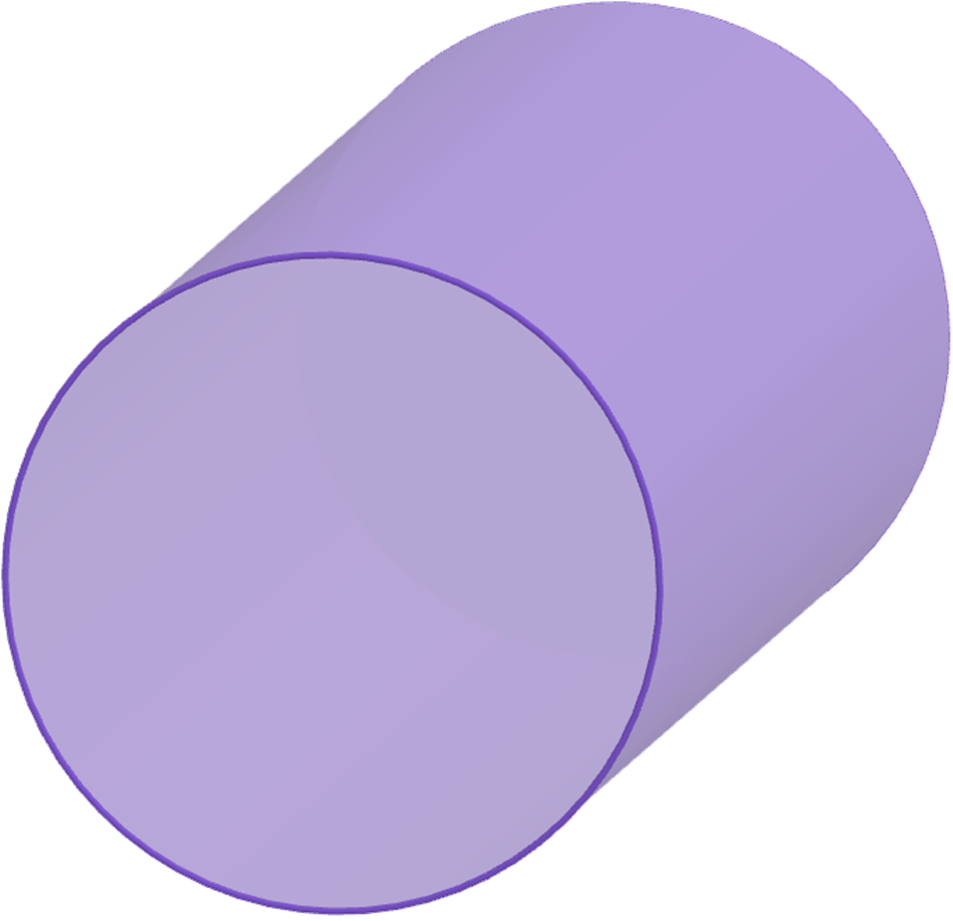
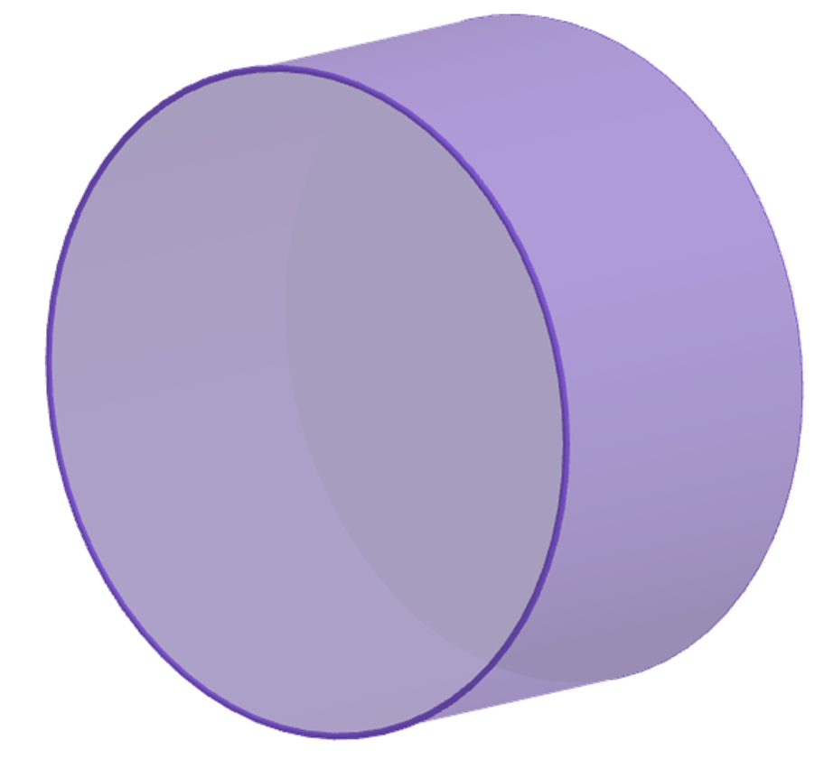
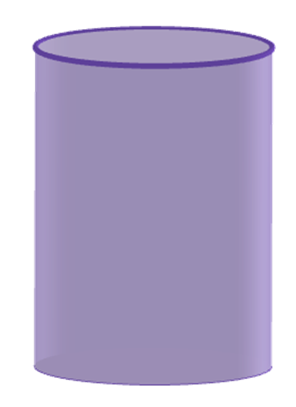
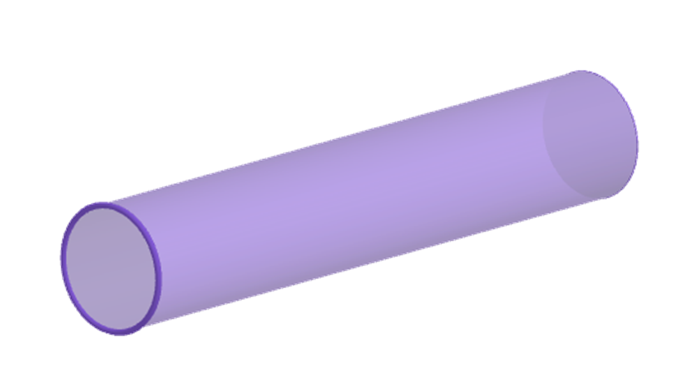


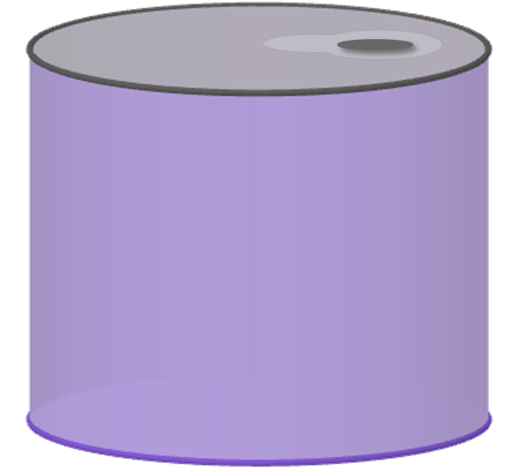
Surface area of cylinders
Task A: Finding the surface area of a cylinder
1) Work out the surface area of the following cylinders
a)
b)
4 cm
4 cm
11 cm
3 cm
c)
d)
90 cm
138 mm
5 m
37 mm
2) A drinks company are looking to use less material when making their cans. These two cans both hold 330 ml of liquid. Which can should the drinks company choose?
40 mm
109 mm
a
b
66 mm
62 mm

Slide 2
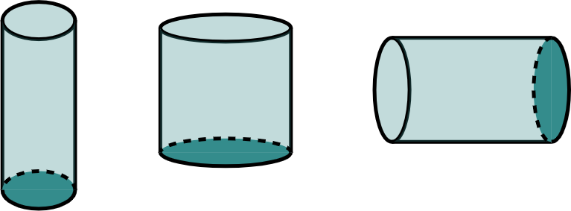
Surface area of cylinders
Task B: Using the surface area of a cylinder
1) Find the missing length in each question. Give your answer in cm.
3 cm
12 cm
c cm
b cm
80 mm
a cm
Surface area
= 88𝜋 cm²
Surface area
= 168𝜋 cm²
Surface area
= 78𝜋 cm²
2) A necklace is being made. Part of the design is a metal cylindrical rod.
The rod is gold-plated. 208𝜋 mm² of gold leaf is used. The rod has a diameter of 4 mm.
How long is the rod?
Mathematics in Education and Industry.
v2.2

